Slide 1

AYURKA RESEARCH LAB LLP.
Fundamentals of Pesticide Residues and Analytical Testing
Presented by:
Mr. Sunit Kumar

Slide 2
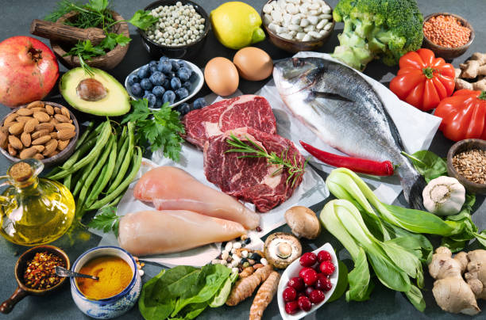
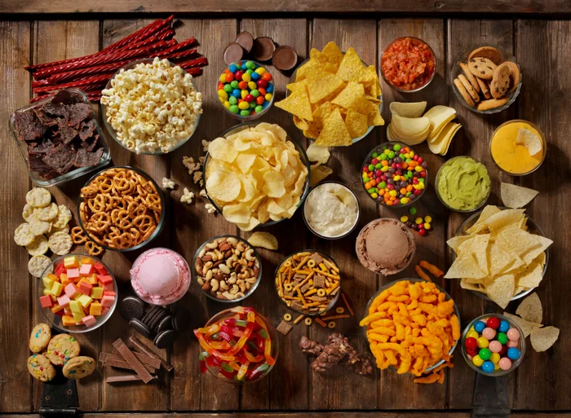
What is Food & Food Products?
Food is any substance that is consumed to provide nutritional support for the body.
It includes items that are eaten or drunk by humans for growth, energy, and health.
Examples : Fruits, vegetables, milk, grains, meat, etc.
Food products are processed or manufactured items made from one or more food ingredients.
They may be raw, semi-processed, or fully processed, and are intended for human consumption.
Examples : Biscuits, bread, jam, packaged juice, yogurt etc.

Slide 3
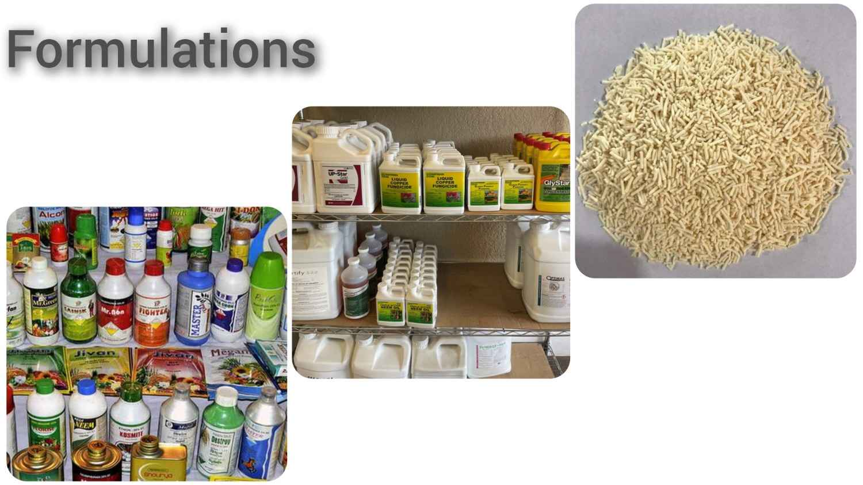
What is a Pesticide?
Pesticides are chemical or biological substances used to protect crops by controlling pests such as insects, weeds, fungi, and rodents. They play a vital role in modern agriculture by improving crop yield, ensuring food security, and reducing post-harvest losses.
However, when not used responsibly, pesticide residues can remain in soil, water, and food products, raising concerns about human health and environmental safety. This makes pesticide residue testing essential to ensure compliance with safety standards and to protect consumers.

Slide 4
Types of Pesticides:
Pesticides
Herbicides
Fungicides
Rodenticides
Nematicides
Bactericides
Insecticides
DDT, Malathion
Glyphosate, Atrazine
Mancozeb, Carbendazim
Zinc phosphide
Aldicarb
Copper compounds

Slide 5
Types of Pesticides and Their Uses
Type | Target Pest | Common Uses
Insecticides | Insects (e.g., mosquitoes, beetles) | Used in agriculture to protect crops; in public health to control disease vectors like mosquitoes.
Herbicides | Weeds and unwanted plants | Widely used in farming to eliminate weeds and improve crop yield.
Fungicides | Fungi and mold | Protect crops from fungal diseases (e.g., mildew, rust); also used in food storage.
Rodenticides | Rodents (rats, mice) | Used in urban areas, homes, and storage facilities to control rodent populations.
Nematicides | Nematodes (microscopic worms) | Applied in soil to control root-damaging nematodes in crops.
Bactericides | Bacteria | Control bacterial diseases in plants. Also used in sanitation.
Larvicides | Larvae of insects (e.g., mosquitoes) | Used in stagnant water and drains to prevent mosquito breeding.
Molluscicides | Snails and slugs | Used in rice and vegetable farming to protect against mollusks.

Slide 6
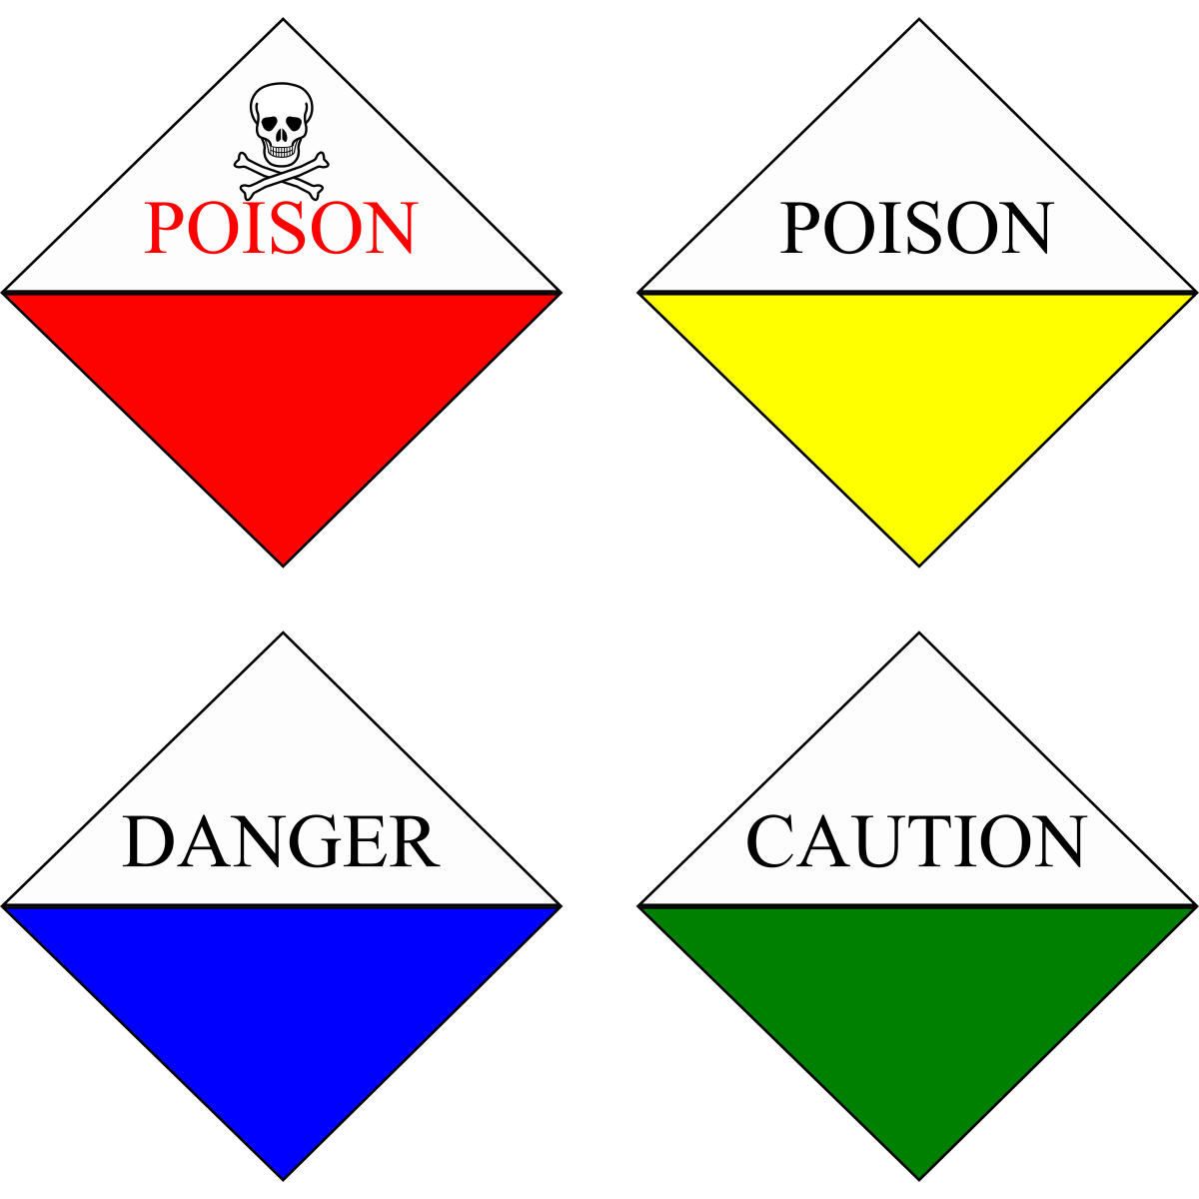
Classification of Pesticides by Hazard as per WHO
Class Ia & Ib – Extremely Hazardous & Highly Hazardous Pesticides
Class II – Moderately Hazardous Pesticides
Malathion, Chlorpyrifos, Cypermethrin, Deltamethrin, Mancozeb
Class III – Slightly Hazardous Pesticides
Class IV – Unlikely to Present Hazard
Class Ia: Parathion, Aldicarb, Phorate, Methyl Parathion, Zinc Phosphide.
Class Ib: Monocrotophos, Methomyl, Carbofuran, Dicrotophos, Disulfoton
Neem oil, Pyrethrins, Dimethoate
Spinosad, Sulfur

Slide 7
Routes of Exposure
Ingestion – through residues on food and water.
Dermal contact – skin exposure during application.
Inhalation – breathing in sprays or vapors

Slide 8
What is the source of Pesticides in Food?
Agricultural Practices: Pesticides are applied directly on crops during cultivation to protect them from pests, diseases, and weeds.
Examples: Spraying insecticides on fruits or vegetables, applying herbicides on grains.
Post-Harvest Treatments: Pesticides may be used after harvest to prevent spoilage during storage and transport.
Examples: Fumigants used in grain storage, fungicides on citrus fruits.
Environmental Contamination: Residues can come from soil, water, or air contaminated by previous pesticide use.
Examples: Groundwater contaminated with persistent pesticides, spray drift from nearby fields.
Cross-Contamination: During handling, transport, or packaging, food can come into contact with contaminated surfaces or other treated products.
Examples: Sharing processing equipment for organic and non-organic foods.
Illegal or Excessive Use: Sometimes farmers exceed permitted limits or use banned substances, leading to high residues.
Examples: Use of non-approved pesticides or ignoring pre-harvest intervals.

Slide 9
Health Implications of Pesticide Residues
Acute Health Effects:
(Short-Term Exposure)
Nausea and vomiting
Dizziness and headaches
Chronic Health Effects:
(Long-Term Exposure)
Cancer (carcinogenic potential of some pesticides)
How to Reduce Risk:
Follow MRL (Maximum Residue Limit) guidelines of FSSAI
Skin irritation or rashes
Abdominal pain
Reproductive disorders (e.g., infertility, birth defects)
Hormonal imbalance (endocrine disruption)
Liver and kidney damage
Neurological disorders (e.g., Parkinson's, developmental delays)
Higher risk for: Infants and children (developing organs), Pregnant women, Elderly people
Promote Good Agricultural Practices (GAP)
Wash, peel, and cook produce where possible
Monitor regularly through residue testing

Slide 10
Importance of Pesticide Residue Testing
Pesticides are widely used in agriculture to protect crops from pests, weeds, and diseases. However, when these chemicals remain in food, water, or the environment beyond safe levels, they can pose significant risks to human health, animal well-being, and ecological balance. Pesticide residue testing plays a vital role in ensuring safety, compliance, and sustainability.
For Human Health
For Animal Health
For the Environment
For Regulatory and Trade Compliance

Slide 11
For Human Health
Food Safety Assurance: Residue testing ensures that fruits, vegetables, grains, milk, meat, and other food products are safe for consumption and within regulatory limits.
Preventing Health Hazards: Excess pesticide residues are linked to acute poisoning, hormonal disruption, neurological issues, reproductive problems, and long-term illnesses such as cancer.
Consumer Confidence: Testing builds trust among consumers by guaranteeing that the food they eat is safe and of high quality.
For Animal Health
Feed Safety: Animals often consume feed, fodder, or water that may contain pesticide residues. Testing ensures the safety of animal diets.
Preventing Bioaccumulation: Residues can accumulate in animal tissues, milk, eggs, or meat, eventually entering the human food chain.
Protecting Livestock Productivity: Healthy livestock free from harmful pesticide exposure lead to better productivity and safer animal-derived products.
For the Environment :
Soil and Water Protection: Residue testing helps monitor contamination in soil, groundwater, rivers, and lakes, preventing long-term ecosystem damage.
Biodiversity Conservation: Pesticides can harm non-target organisms such as bees, birds, fish, and beneficial insects. Testing reduces risks to biodiversity.
Sustainable Agriculture: Regular monitoring encourages responsible pesticide use, supporting eco-friendly and sustainable farming practices.
For Regulatory and Trade Compliance:
Legal Requirements: National and international food safety authorities (such as FSSAI, EU, Codex, and USFDA) set Maximum Residue Limits (MRLs). Testing ensures compliance with these standards.
Facilitating Export and Trade: Agricultural exports must meet strict residue regulations. Testing helps farmers and producers access global markets without rejection.

Slide 12
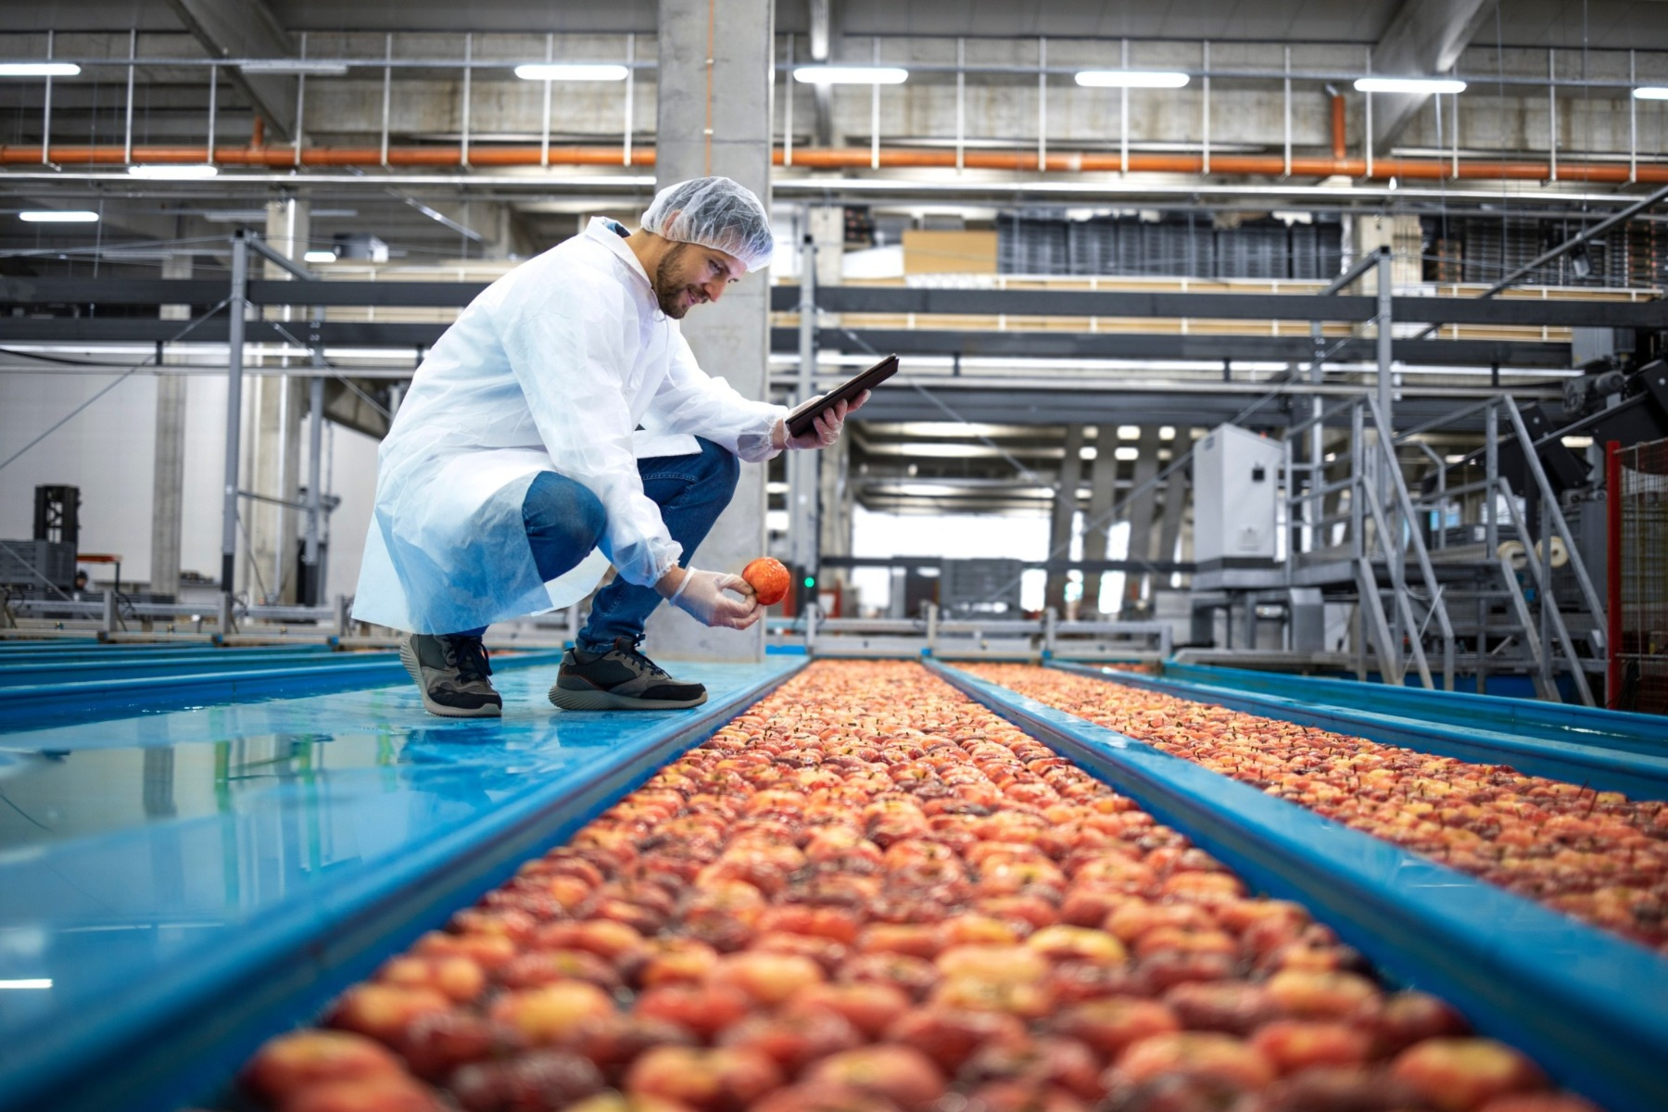
What is Sampling?
Sampling is the process of selecting a representative portion from a larger batch or lot of food or water to test for pesticide residues.
It ensures that test results accurately reflect the safety and quality of the entire batch.
Objectives:
To obtain a representative sample of the whole lot
To ensure reliable and reproducible results
To detect non-compliance with MRLs (Maximum Residue Limits)
To support regulatory action or quality assurance
Food Sampling Guidelines:
Follow Codex, FSSAI, or AOAC methods and laboratory Process (SOPs)
Use clean, inert tools (stainless steel, glass)
Avoid contamination (no bare hands, no plastic bags)
Store at correct temperature (e.g., chilled or frozen)
Label properly: sample ID, date, source, matrix

Slide 13
Laboratory Work
Sample Receipt and Storage:
Receive sample under chilled conditions (0–4°C).
Log sample in sample register.
Store perishable items in fridge; long-term in freezer (-20°C or lower).
Commination (Grinding/Blending)
Homogenize the entire laboratory sample to ensure even distribution of residues.
Use knife mills, blenders, or cryogenic grinding (for high-fat/freeze-sensitive samples).
Avoid contamination and heat build up during grinding.
Subsampling from Homogenate
Mix homogenized sample thoroughly before subsampling.
Weigh subsample (e.g., 10–15 g) into extraction tube.
Proceed immediately with QuEChERS or freeze until extraction.

Slide 14
QuEChERS Method
Quick
The method is relatively fast compared to traditional extraction methods.
The procedure is straightforward and requires minimal equipment.
Cheap
The method uses relatively safe solvents and reagents.
Effective
Rugged
Safe
Easy
The cost of materials is relatively low.
The method provides efficient extraction and clean-up of target analytes.
The method is robust and can be adapted for various sample types.
The method was first introduced at the European Pesticide Residue Workshop (EPRW) in 2002 and officially published in 2003.
Originally developed for pesticide residue analysis in fruits and vegetables, QuEChERS has proven to be highly versatile for extracting and purifying analytes from complex matrices due to its strong stability and broad applicability. As a result, it is now widely used to extract various analytes and contaminants such as animal drug residues, Mycotoxins, polycyclic aromatic hydrocarbons (PAHs), polychlorinated biphenyls (PCBs), and Polybrominated diphenyl ethers (PBDEs). QuEChERS has been adopted as a standardized method by international organizations such as AOAC International and the European Committee for Standardization (CEN), with notable examples including AOAC 2007.01 and EN 15662:2008.

Slide 15
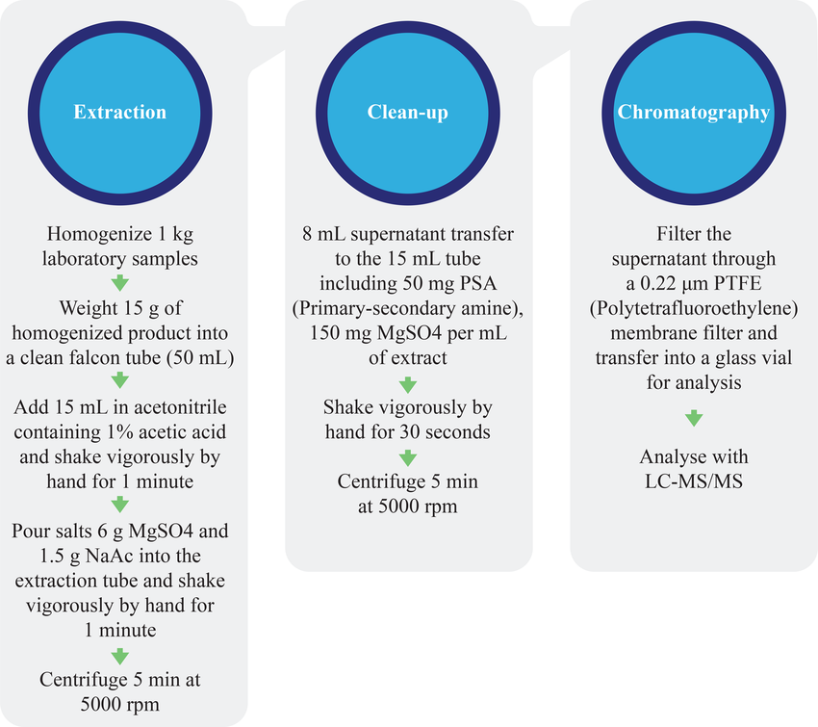
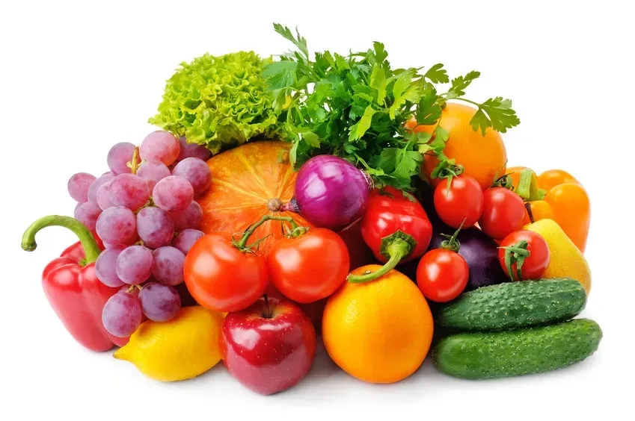
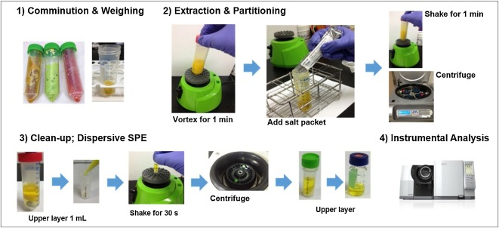
Methodology

Slide 16
Original QuEChERS Method
Sample Preparation:
Extraction:
AOAC Official Method 2007.01 (Buffered QuEChERS)
Sample Preparation:
Buffered Partitioning:
EN 15662 (CEN QuEChERS Method – Citrate Buffered)
Sample Preparation:
Extraction:
Homogenize the sample.
Weigh 10 g of sample into a 50 mL centrifuge tube.
Add 10 mL of acetonitrile (MeCN).
Shake vigorously for 1 minute.
Salting Out Partitioning:
Add salt mixture:
4 g MgSO₄
1 g NaCl
Shake immediately for 1 minute.
Centrifuge for 5 minutes at 4000 rpm.
Analysis:
Analyze using GC-MS/MS or LC-MS/MS.
Homogenize sample.
Weigh 15 g of high water content sample into a 50 mL tube.
Extraction:
Add 15 mL of acetonitrile with 1% acetic acid.
Shake vigorously for 1 minute.
Add salt mixture:
6 g MgSO₄
1.5 g Sodium Acetate (NaOAc)
Shake immediately for 1 minute.
Centrifuge at 4000 rpm for 5 min.
d-SPE Cleanup:
Transfer 1 mL of upper MeCN layer to a d-SPE tube containing:
150 mg MgSO₄
50 mg PSA
50 mg C18 (optional: 7.5 mg GCB)
Shake, centrifuge.
Analysis:
Analyze using GC-MS/MS or LC-MS/MS.
Homogenize the sample.
Weigh 10 g into a 50 mL centrifuge tube.
Add 10 mL acetonitrile.
Shake for 1 minute.
Buffered Partitioning:
Add salt mixture:
4 g MgSO₄
1 g NaCl
1 g Trisodium citrate dihydrate (Na₃Citrate·2H₂O)
0.5 g Disodium hydrogen citrate sesquihydrate (Na₂HCitrate·1.5H₂O)
Shake for 1 minute.
Centrifuge at 4000 rpm for 5 minutes.
d-SPE Cleanup:
Transfer 1 mL supernatant into d-SPE tube containing:
150 mg MgSO₄
25 mg PSA
25 mg C18
7.5 mg GCB
Shake, centrifuge.
Analysis:
Analyze using GC-MS/MS or LC-MS/MS.

Slide 17
Role of Reagent in Extraction and Partitioning
Acetonitrile (MeCN)
Main extraction solvent. It efficiently extracts a wide range of pesticides from food matrices due to its intermediate polarity and immiscibility with water. It also causes phase separation when salts are added.
Anhydrous Magnesium Sulfate (MgSO₄)
A drying agent used to remove residual water from the organic phase during salting-out extraction.
Sodium Citrate (Na₃C₆H₅O₇) & Disodium Hydrogen Citrate Sesquihydrate (Na₂HC₆H₅O₇·
1.5H₂O)
These are used in buffered QuEChERS methods (AOAC 2007.01 and EN 15662). They stabilize pH (~5–5.5), preventing degradation of pH-sensitive pesticides (e.g., captan, folpet, and dithiocarbamates).
Sodium Chloride (NaCl)
Enhances phase separation (salting out) between the aqueous and organic layers and helps reduce co-extraction of polar compounds.

Slide 18
Role of Reagent in d-SPE Clean-up
Removes polar organic acids, some sugars, and fatty acids. Helps reduce matrix interferences.
C18 (Octadecylsilane)
Retains and removes non-polar interferences such as fats, lipids, and sterols, especially important in fatty samples (e.g., meat, dairy).
Anhydrous Magnesium Sulfate (MgSO₄)
Again used here to remove any residual water during the clean-up step. Ensures a dry extract suitable for GC or LC analysis.).
Graphitized Carbon Black (GCB)
Removes pigments (e.g., chlorophyll, carotenoids) in colored fruits/vegetables. Must be used cautiously as it can also adsorb planar pesticides.
Primary Secondary Amine (PSA)

Slide 19
Extension to Other Food Categories: Challenges & Solutions
High-Fat Foods
Meat, Fish, Dairy, Eggs
Challenges
Highly Pigmented Foods
Spinach, Chili, Tea, Herbs
Challenges
Dry Foods
Liquid Foods
Difficult to extract polar pesticides
Lipids cause severe matrix effects, contaminate MS source
Solutions
Use C18, Z-Sep, or EMR-Lipid sorbents to remove fats
Freeze-out lipids at -20°C before cleanup
Cereals, Grains, Spices
Challenges
High starch/sugar → co-extraction of interference
Solutions
Add PSA or graphitized carbon black (GCB) for cleanup
Low moisture → poor extraction efficiency
Add water (5–10 mL) to hydrate sample before extraction
Juice, Milk, Wine, Honey
Challenges
High sugar/protein → matrix interference
Sticky matrix (e.g., honey) → pipetting and analysis issues
Solutions
Add extraction salts to improve phase separation
Use PSA to remove sugars and proteins
Low organic content → poor partitioning
Dilute the sample and apply freeze-out or dual cleanup
Processed Foods
Chlorophyll, pigments interfere with MS
Some pesticides adsorbed on pigments
Co-extraction of plant metabolites
Solutions
Add GCB for pigment removal (use carefully to avoid pesticide loss)
Combine PSA + C18 + GCB for better cleanup
Reduce GCB quantity or use modified GCB
Baby food, baked products
Challenges
Complex and variable matrices
Oil, sugar, additives interfere with analysis
Solutions
Use internal standards (ILIS) and matrix-matched calibration
Apply multi-sorbent d-SPE cleanup tailored to matrix type

Slide 20
Expansion to Other Food Categories
Modified with additional hydration step for dry samples.
Buffers adjusted to maintain pH.
Inclusion of lipid removal sorbents (C18, EMR-Lipid).
Adjustments for fat interferences.
More aggressive clean-up using GCB and PSA to remove fats and pigments.
Further sorbents like Z-Sep introduced.
Modified extraction using hexane partitioning or freeze-out step.
Extensive d-SPE to eliminate non-polar interferences.
Extra sensitivity and specificity required.
Clean-up using high-purity reagents and careful pH control.
Addressed complex matrices with pigments and essential oils.
Often requires multi-step clean-up or dual QuEChERS-GPC approach.
Modified extraction and concentration techniques due to low organic content.

Slide 21
Techniques Used in QuEChERS Methodology
Liquid-Liquid Extraction
Solid-Liquid Extraction
Solid-Phase Extraction

Slide 22
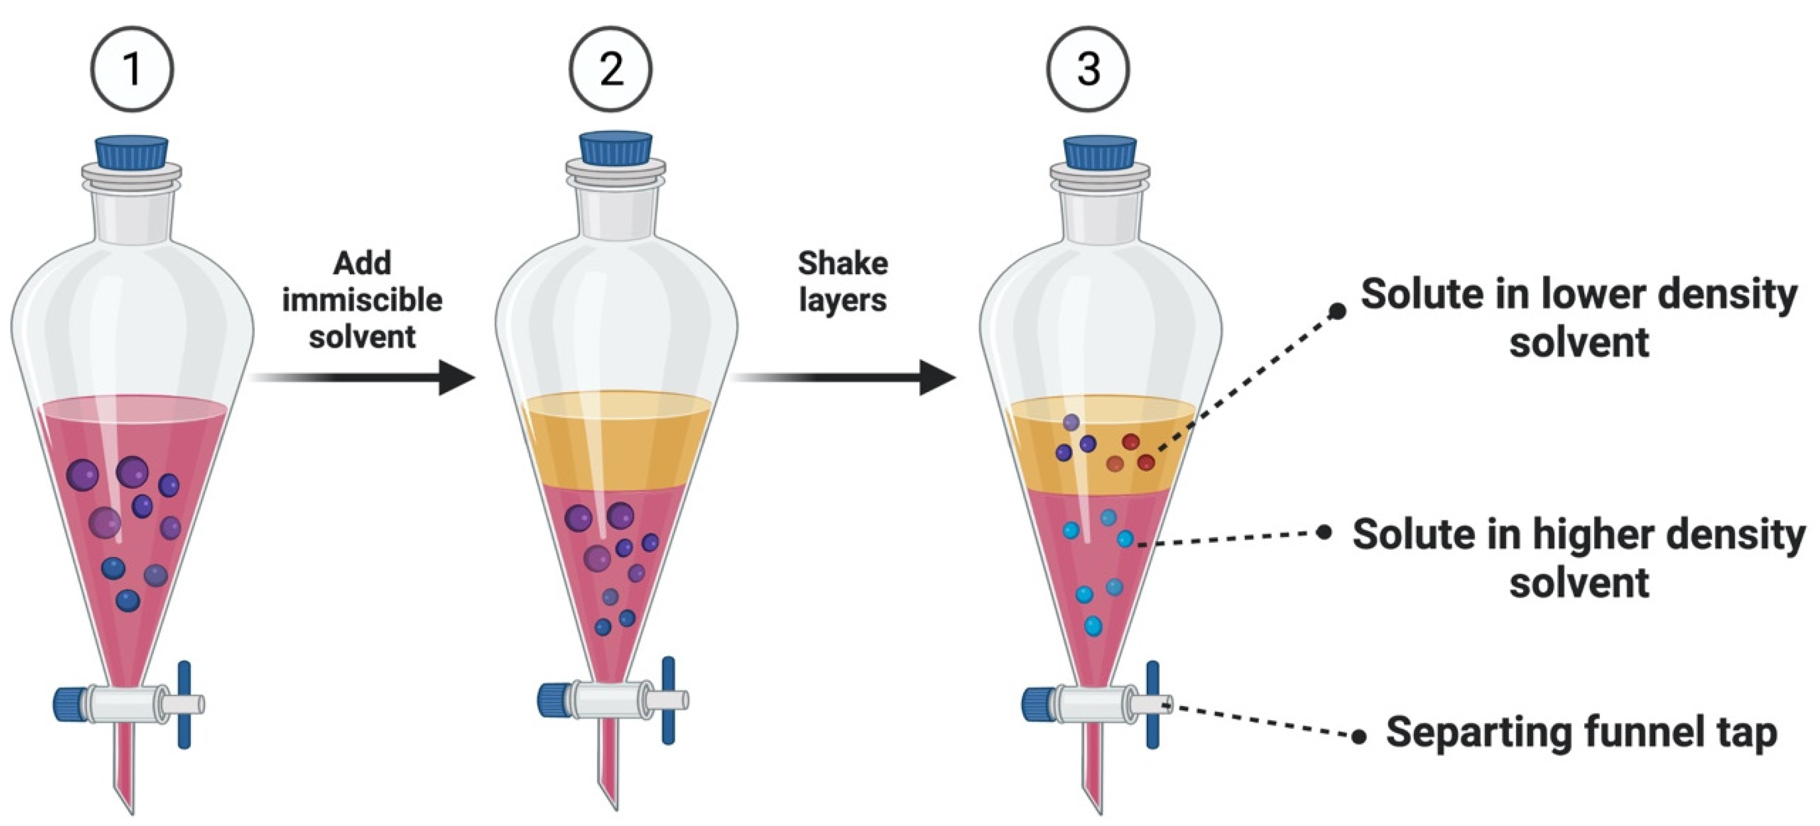
Liquid-Liquid Extraction

Slide 23
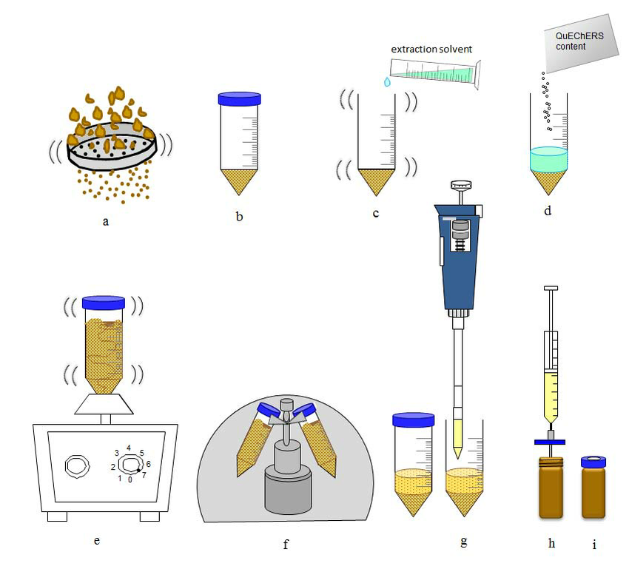
Solid-Liquid Extraction

Slide 24
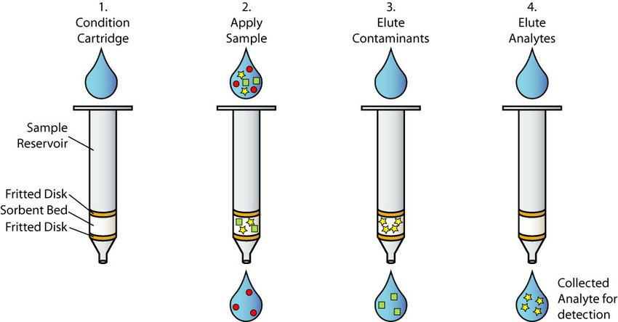
Solid-Phase Extraction

Slide 25
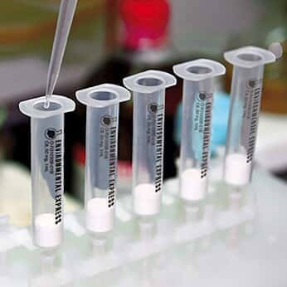
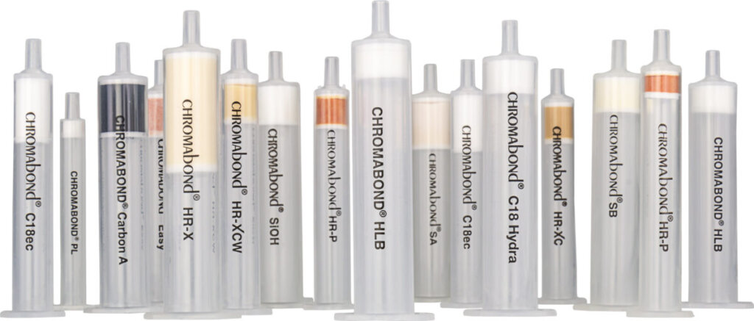
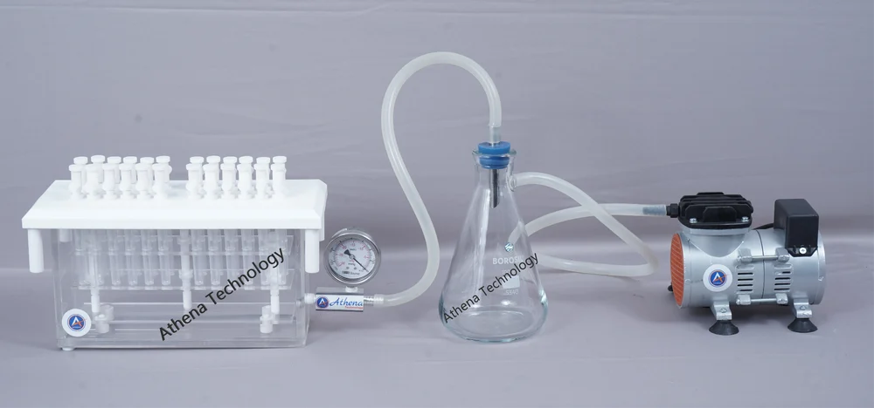
SPE Manifold

Slide 26
Types of Syringe Filters and Their Uses
Filter Type | Membrane Material | Pore Size (µm) | Common Uses
Nylon | Polyamide (Nylon) | 0.22, 0.45 | General-purpose; used for aqueous & most organic solvents; strong mechanical strength.
PTFE | Polytetrafluoroethylene | 0.22, 0.45 | Ideal for aggressive organic solvents, acids, bases; hydrophobic.
PVDF | Polyvinylidene fluoride | 0.22, 0.45 | Low protein-binding; used for protein solutions, biological samples.
PES | Polyethersulfone | 0.22, 0.45 | Used for aqueous solutions, buffer filtration; low extractables.
Cellulose Acetate | CA | 0.22, 0.45 | Low protein binding; used in cell culture, aqueous filtration.
Regenerated Cellulose (RC) | RC | 0.2, 0.45 | Compatible with aqueous and organic solvents; good for HPLC sample prep.
Glass Fiber (GF) | Borosilicate Glass | 0.7 – 1.2 | Used as pre-filters for turbid or particulate-rich samples.
Mixed Cellulose Ester (MCE) | MCE | 0.22, 0.45 | High flow rate; used for microbial analysis and aqueous sample filtration.
Polypropylene (PP) | PP | 0.45 | Chemical resistant; used for clarification of solvents and acids.

Slide 27
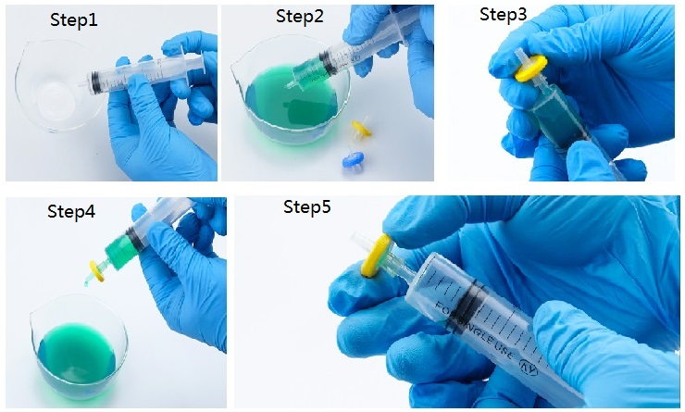
How to use syringe filter?

Slide 28
Key Importance of Syringe Filters in Residue Labs:
Purpose | Explanation
1. Sample Clarification | Removes particulate matter, dust, and food debris that can clog columns.
2. Protects Instruments | Prevents blockage or damage to LC-MS/MS, GC-MS injection ports and columns.
3. Enhances Accuracy | Ensures clean, consistent samples for reliable quantitative results.
4. Reduces Background Noise | Removes undissolved particles that can interfere with chromatogram baselines.
5. Prevents Cross-Contamination | Disposable filters minimize carryover between samples.
6. Increases Column Life | By removing solid residues, it prolongs the life of expensive analytical columns.
7. Complies with GLP/QC norms | Filtration is part of standard sample preparation SOPs in regulated labs.
8. Saves Time & Costs | Prevents reruns and instrument maintenance due to contamination or blockages.

Slide 29
General Precautions in Pesticide Residue Testing Lab & Their Impact
S.No. | Precaution | Purpose / Description | Impact if Not Followed
1 | Use of PPE (Gloves, Lab coat, Goggles, Mask) | To protect from toxic pesticide exposure and contamination. | Health hazards, skin absorption, inhalation risk, sample contamination.
2 | Labeling of Samples and Reagents Properly | Ensures traceability and prevents mix-ups. | Misidentification of samples, invalid results, regulatory non-compliance.
3 | Avoid Cross-Contamination | Use separate tools and glassware for each sample; clean work area. | False positives or elevated residues due to contamination.
4 | Use Clean and Calibrated Glassware | Prevents inaccurate volumes or reagent carryover. | Errors in extraction and quantification.
6 | Follow Proper Waste Disposal | Segregate pesticide, solvent, and biological waste as per hazardous waste rules. | Environmental pollution, lab closure, legal action.
7 | Maintain Equipment Regularly | Calibrate and service instruments | Inaccurate readings, instrument breakdown, high maintenance costs.
8 | Avoid Eating/Drinking in Lab Area | Prevent ingestion of residues and accidental exposure. | Health hazard, especially from toxic pesticide residues.
9 | Proper Storage of Standards and Reagents | Store at required temperatures (e.g., -20°C for some standards) to maintain stability. | Degraded standards, incorrect quantification, and poor recoveries.
10 | Documentation and Record Maintenance | Maintain raw data, calibration logs, and SOP compliance. | Non-compliance with GLP and audit failure.

Slide 30

Well Done!
You’ve successfully completed the training. Now, tell us what you think.
your feedback matters.
Note: Participants who wish to obtain a e-certificate for this training are required to complete the assessment and pay a fee of ₹499 per person. The electronic certificate will then be issued and sent to the registered email address.
Click here to attempt the questions.
https://docs.google.com/forms/d/e/1FAIpQLSdXaFcgAtaZGVPwm3PX-8UzjrgQRqse_dylLSfNwoO9rcS0_w/viewform?usp=sharing&ouid=104469698987664698276
After completing the test, kindly make the payment and share the transaction details using the QR code provided below.

Slide 31

Sample Certificate

